Slide 1


LECTURE 4
Neural
networks
Foundations of Artificial Intelligence
SEMTM0051 · 2026/27
Lecturer: Dr Roberto Colomboni
Notes:
Suggested time: 0.5 min.
Lecture 4. The cover follows the established University of Bristol design.
Source: SEMTM0051_week4_neural_networks_generalisation.tex, lecture notes by Roberto Colomboni.

Slide 2
Today’s lecture
Affine features and activation functions
Affine features and activation functions
Neural networks and the forward pass
What neural networks can represent
Fitting neural networks and local minima
Foundations of AI · Lecture 4
2
Notes:
Part 1: Affine layers and activation functions. Introduce the four parts of the lecture, then begin with affine layers and activation functions.

Slide 3


Why neural networks?
So far, we have chosen the features
and fitted the output parameters.
$$f(x)=b+w_{1}x+w_{2}x^{2}$$
Fixed feature functions
$$φ_{1}\left(x\right)=1, φ_{2}\left(x\right)=x, φ_{3}\left(x\right)=x^{2}$$
Adjustable coefficients
$$b, w_{1}, w_{2}$$
Can we also learn the features from data?
Foundations of AI · Lecture 4
3
Notes:
Suggested time: 1.2 min.
Recall the end of Lecture 2. The feature functions are fixed even though the predictor is nonlinear in x. The coefficients are what training changes.
Source: SEMTM0051_week4_neural_networks_generalisation.tex, lecture notes by Roberto Colomboni.

Slide 4



Learning the feature functions
A neural network places adjustable parameters inside the feature functions.
$$f\left(x\right)=b+\sum_{j=1}^{m}{w_{j}φ_{j}\left(x\right)}$$
Feature functions with
adjustable parameters
Parameters combining the values of the feature functions
$$φ_{1},…,φ_{m}$$
$$b, w_{1},…,w_{m}$$
How do we do that?
First, let us try affine feature functions with adjustable coefficients.
Foundations of AI · Lecture 4
4
Notes:
Suggested time: 1.3 min.
Preview only. We will define the feature functions concretely using affine transformations and ReLU. All feature values form a row, while scalar-output weights form a column.
Source: SEMTM0051_week4_neural_networks_generalisation.tex, lecture notes by Roberto Colomboni.

Slide 5

A first idea: affine feature functions
Make each feature map an affine function of the input.
$$x=\left(x_{1},…,x_{d}\right)∈ℝ^{1×d}, W=\left(\begin{matrix}W_{11} & ⋯ & W_{1m} \\ ⋮ & ⋱ & ⋮ \\ W_{d1} & ⋯ & W_{dm}\end{matrix}\right) ∈ℝ^{d×m}, b=\left(b_{1},…,b_{m}\right)∈ℝ^{1×m}$$
$$φ_{j}\left(x\right)=\underset{weighted sum}{\underbrace{\sum_{k=1}^{d}{x_{k}W_{kj}}}}+\underset{bias}{\underbrace{b_{j}}}, j=1,…,m$$
$$φ\left(x\right)=\left(φ_{1}\left(x\right),…,φ_{m}\left(x\right)\right)=xW+b∈ℝ^{1×m}$$
The weights $W$ and biases $b$ determine the feature functions.
Foundations of AI · Lecture 4
5
Notes:
This is a first attempt, not yet the final neural-network feature construction. Each column of W and one bias define one feature. All entries of W and b are adjustable. We retain the input notation x from the previous slide.

Slide 6




An affine feature and an affine output
The composition of two affine functions is an affine function.
Feature function
Affine output
$$φ\left(x\right)=w_{1}x+b_{1}$$
$$f\left(x\right)=w_{2}φ\left(x\right)+b_{2}$$
$$w_{1}=2, b_{1}=1$$
$$w_{2}=3, b_{2}=−4$$
$$f\left(x\right)=3\left(2x+1\right)−4=6x−1$$
We can write the same predictor directly as an affine function of $x$,
with no intermediate features:
$$f(x)=\tilde{w}x+\tilde{b}, \tilde{w}=6, \tilde{b}=−1$$
Foundations of AI · Lecture 4
6
Notes:
The feature has weight w1=2 and bias b1=1. The output has weight w2=3 and bias b2=-4. Substitution gives the identical predictor f(x)=6x-1 for every input x. The equivalent direct model has weight w_tilde=w2*w1=6 and bias b_tilde=w2*b1+b2=-1. This is an exact equivalence of functions, not an approximation or a statement about fitted values on a particular dataset.

Slide 7
Affine features still give an affine predictor
Same problem for any number of affine features.
$$φ(x)=xW+b$$
Output weights and bias:
$$w_{out}∈ℝ^{m×1}, b_{out}∈ℝ$$
$$f(x)=φ(x)w_{out}+b_{out}$$
$$f\left(x\right)=x\underset{≕\tilde{w}}{\underbrace{Ww_{out}}}+\underset{≕\tilde{b}}{\underbrace{bw_{out}+b_{out}}}=x\tilde{w}+\tilde{b}$$
$f$ is still an affine function with equivalent weight column and bias:
$$\tilde{w}≔Ww_{out}∈ℝ^{d×1}, \tilde{b}≔bw_{out}+b_{out}∈ℝ$$
Repeating the argument: the composition of any number of affine maps remains affine.
We need a nonlinear operation between the affine maps.
Foundations of AI · Lecture 4
7
Notes:
The feature parameters are W of size d by m and the row b of length m. The output uses the m by 1 weight column w_out and scalar bias b_out. The equivalent direct weight column is w_tilde=W*w_out, of size d by 1. The equivalent scalar bias is b_tilde=b*w_out+b_out. Hence f(x)=x*w_tilde+b_tilde for every input x. This is the same identification made numerically on the preceding slide. For vector outputs, replace the output weight column by a matrix and the bias scalar by a row: composition is still affine. Combining successive stages two at a time therefore proves that any finite sequence of affine transformations is affine. Additional affine stages alone cannot produce nonlinear predictors.

Slide 8


The ReLU activation function
We now apply a nonlinear function to each affine value.
We use ReLU (short for Rectified Linear Unit).
$$ReLU(a)=max\{0,a\}$$
$$=\left\{\begin{matrix}0 & a≤0 \\ a & a>0\end{matrix}\right.$$
a
Each feature combines an affine transformation with ReLU.
Foundations of AI · Lecture 4
8
Notes:
Suggested time: 1.2 min.
Rectified linear unit. Scalar input and scalar output. Emphasise continuity and the change of slope at zero; differentiation comes at the end.
Source: SEMTM0051_week4_neural_networks_generalisation.tex, lecture notes by Roberto Colomboni.

Slide 9
Today’s lecture
Affine features and activation functions
Neural networks and the forward pass
What neural networks can represent
Fitting neural networks and local minima
Foundations of AI · Lecture 4
9
Notes:
Part 2: Neural networks and the forward pass. Briefly locate this part in the lecture before continuing.

Slide 10






















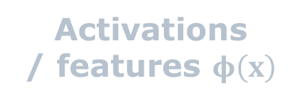
A first example – the weighted sum
$$x=\left(1,2\right), W=\left(\begin{matrix}1 & 2 & −1 \\ −1 & 0 & 1\end{matrix}\right), b=\left(0,1,0\right)$$
Input
Weighted sums $xW$
Preactivations
$$xW+b$$
Activations
/ features $φ\left(x\right)$
$$1(1)+2(−1)$$
$$+0$$
$$?$$
ReLU
$$?$$
$$1$$
$$=−1$$
$$1$$
$$−1$$
$$2$$
$$1(2)+2(0)$$
$$+1$$
$$?$$
ReLU
$$?$$
$$0$$
$$=2$$
$$2$$
$$−1$$
$$1$$
$$+0$$
$$?$$
ReLU
$$?$$
$$1(−1)+2(1)$$
$$=1$$
$$xW=\left(−1,2,1\right)$$
Foundations of AI · Lecture 4
10
Notes:
First compute only xW=(-1,2,1). The input row x, hidden weight matrix W and hidden bias row b remain visible above the diagram. Both preactivations and activations are deliberately left as question marks. The six edge labels are W11=1, W21=-1, W12=2, W22=0, W13=-1, W23=1.
Source: SEMTM0051_week4_neural_networks_generalisation.tex.

Slide 11


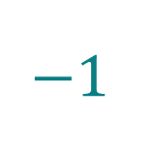










A first example – the preactivations
$$x=\left(1,2\right), W=\left(\begin{matrix}1 & 2 & −1 \\ −1 & 0 & 1\end{matrix}\right), b=\left(0,1,0\right)$$
Input
Weighted sums $xW$
Preactivations
$$xW+b$$
Activations
/ features $φ\left(x\right)$
$$1(1)+2(−1)$$
$$+0$$
$$−1$$
ReLU
$$?$$
$$1$$
$$=−1$$
$$1$$
$$−1$$
$$2$$
$$1(2)+2(0)$$
$$+1$$
$$3$$
ReLU
$$?$$
$$0$$
$$=2$$
$$2$$
$$−1$$
$$1$$
$$+0$$
$$1$$
ReLU
$$?$$
$$1(−1)+2(1)$$
$$=1$$
$$xW+b=\left(−1,3,1\right)$$
Foundations of AI · Lecture 4
11
Notes:
Keep every diagram element and parameter in the same position. Add b=(0,1,0) to the weighted sums (-1,2,1). The preactivation question marks become -1,3,1. The activation values are still unknown.
Source: SEMTM0051_week4_neural_networks_generalisation.tex.

Slide 12







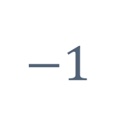



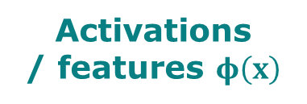







A first example – the activations / features
$$x=\left(1,2\right), W=\left(\begin{matrix}1 & 2 & −1 \\ −1 & 0 & 1\end{matrix}\right), b=\left(0,1,0\right)$$
Preactivations
$$xW+b$$
Activations
/ features $φ\left(x\right)$
Input
Weighted sums $xW$
$$1(1)+2(−1)$$
$$+0$$
$$−1$$
ReLU
$$0$$
$$1$$
$$=−1$$
$$1$$
$$−1$$
$$2$$
$$1(2)+2(0)$$
$$+1$$
$$3$$
ReLU
$$3$$
$$0$$
$$=2$$
$$2$$
$$−1$$
$$1$$
$$+0$$
$$1$$
ReLU
$$1$$
$$1(−1)+2(1)$$
$$=1$$
$$φ\left(x\right)=\left(ReLU\left({\left[xW+b\right]}_{1}\right),ReLU\left({\left[xW+b\right]}_{2}\right),ReLU\left({\left[xW+b\right]}_{3}\right)\right)=\left(0,3,1\right)$$
Foundations of AI · Lecture 4
12
Notes:
Keep the previous calculations visible and all elements in fixed positions. Apply ReLU to the preactivations (-1,3,1). The activation question marks become 0,3,1. These are the values used by the output layer on the next slide.
Source: SEMTM0051_week4_neural_networks_generalisation.tex.

Slide 13




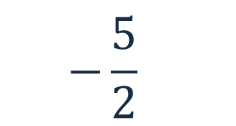


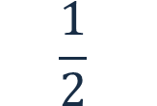
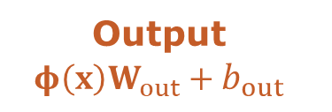



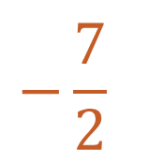
A first example – the output
$$W_{out}={\left(2,−1,\frac{1}{2}\right)}^{⊤}, b_{out}=−1$$
Activations
/ features $φ\left(x\right)$
$$0$$
Weighted sum
$$φ\left(x\right)W_{out}$$
Output
$$φ\left(x\right)W_{out}+b_{out}$$
$$2$$
$$3$$
$$−\frac{5}{2}$$
$$−1$$
$$−\frac{7}{2}$$
$$−1$$
$$\frac{1}{2}$$
$$1$$
$$f\left(\left(1,2\right)\right)=0⋅(2)+3⋅(−1)+1⋅\left(\frac{1}{2}\right)−1=−\frac{7}{2}$$
Foundations of AI · Lecture 4
13
Notes:
Start from the hidden activations 0,3,1. Multiply them by output weights 2,-1,1/2 and add: the weighted sum is -5/2. Add b_out=-1 to obtain -7/2=-3.5. The output is affine: no ReLU is applied here.
Source: SEMTM0051_week4_neural_networks_generalisation.tex.

Slide 14

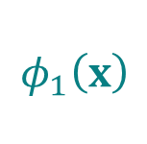


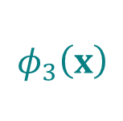

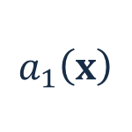
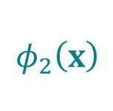
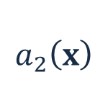


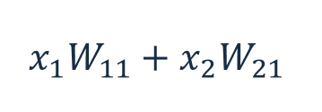

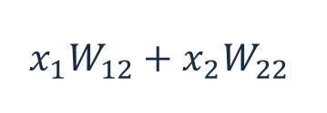

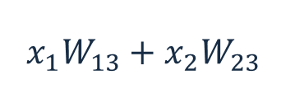




Neurons
A neuron is a function that combines several inputs into one output.
The name is loosely inspired by biological neurons,
which receive signals from other cells and produce an output signal.
Input
Weighted sums
Preactivations
Activations
$$x_{1}W_{11}+x_{2}W_{21}$$
$$+b_{1}$$
$$a_{1}\left(x\right)$$
ReLU
$$φ_{1}\left(x\right)$$
$$x_{1}$$
$$W_{11}$$
$$W_{21}$$
$$W_{12}$$
$$x_{1}W_{12}+x_{2}W_{22}$$
$$+b_{2}$$
$$a_{2}\left(x\right)$$
ReLU
$$φ_{2}\left(x\right)$$
$$W_{22}$$
$$x_{2}$$
$$W_{13}$$
$$W_{23}$$
$$a_{3}\left(x\right)$$
$$φ_{3}\left(x\right)$$
$$x_{1}W_{13}+x_{2}W_{23}$$
$$+b_{3}$$
ReLU
Each horizontal row represents one neuron.
It forms a weighted sum, adds a bias and applies an activation function.
Foundations of AI · Lecture 4
14
Notes:
A hidden unit, also called a neuron, computes one scalar feature value by forming a weighted sum, adding its bias and applying an activation function. Here the activation function is ReLU. Each complete horizontal row represents one hidden unit, with successive intermediate values. The three diagram columns are not three different layers.
One hidden layer of width three, with two input coordinates. Follow each horizontal row: the weighted sum, addition of the bias, then ReLU. The three columns are successive values within the same unit, not three layers. Here j identifies a hidden unit. No layer subscript is needed. The output calculation is introduced on the next slide.
Source: SEMTM0051_week4_neural_networks_generalisation.tex.

Slide 15









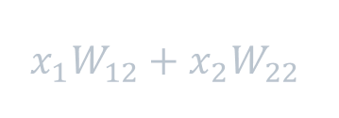
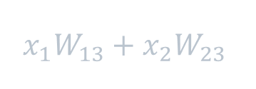

A neuron
The highlighted row shows the complete calculation performed by one neuron.
One neuron
Input
Weighted sums
Preactivations
Activations
$$x_{1}W_{11}+x_{2}W_{21}$$
$$+b_{1}$$
$$a_{1}\left(x\right)$$
ReLU
$$φ_{1}\left(x\right)$$
$$x_{1}$$
$$W_{11}$$
$$W_{21}$$
$$W_{12}$$
$$x_{1}W_{12}+x_{2}W_{22}$$
$$+b_{2}$$
$$a_{2}\left(x\right)$$
ReLU
$$φ_{2}\left(x\right)$$
$$W_{22}$$
$$x_{2}$$
$$W_{13}$$
$$W_{23}$$
$$a_{3}\left(x\right)$$
$$φ_{3}\left(x\right)$$
$$x_{1}W_{13}+x_{2}W_{23}$$
$$+b_{3}$$
ReLU
A neuron is a function that combines its inputs into one output,
called its activation.
Foundations of AI · Lecture 4
15
Notes:
Suggested time: 0.4 min.
The highlighted horizontal row is one hidden neuron. Follow its weighted sum, the addition of its own bias, its preactivation, and the scalar ReLU that produces its activation. The three displayed values belong to one calculation, not three neurons or three layers.
The other two rows are two further neurons in the same hidden layer. The input coordinates are shared; each neuron has its own weights and bias. The output phi_1(x) is the value produced by the highlighted neuron.
Source: SEMTM0051_week4_neural_networks_generalisation.tex.

Slide 16
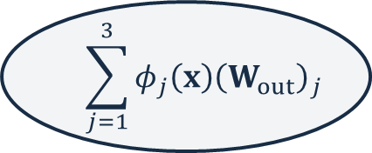


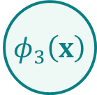



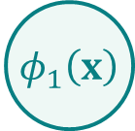




The output layer
Together, these neurons and the affine output layer form a neural network.
The output layer combines the neurons’ activations using weights and a bias.
$$f\left(x\right)=\sum_{j=1}^{3}{φ_{j}\left(x\right){\left(W_{out}\right)}_{j}}+b_{out}=\left(φ_{1}\left(x\right),φ_{2}\left(x\right),φ_{3}\left(x\right)\right)W_{out}+b_{out}$$
Output weights and bias:
$${ x}_{1}$$
$$φ_{1}\left(x\right)$$
$$(W_{out})_{1}$$
$$W_{out}∈ℝ^{3×1}, b_{out}∈ℝ$$
$$φ_{2}\left(x\right)$$
$$\sum_{j=1}^{3}{φ_{j}\left(x\right){\left(W_{out}\right)}_{j}}$$
$$+b_{out}$$
$$f(x)$$
$$(W_{out})_{2}$$
$$φ_{3}\left(x\right)$$
$$(W_{out})_{3}$$
$${ x}_{2}$$
Input
Hidden layer
Weighted sum
Output
These neurons form a hidden layer:
their activations are intermediate values, computed inside the network.
Foundations of AI · Lecture 4
16
Notes:
Suggested time: 0.8 min.
The three middle circles contain the activations produced by the three hidden neurons described on the preceding slides. Each circle summarises the weighted sum, bias and ReLU calculation for one neuron. They are not a new set of hidden neurons.
For a scalar output, combine the three activations using one output weight per neuron, then add the output bias. The output weights form a 3 by 1 column. The displayed sum is the component form of the row-times-column product. The affine output here does not apply another ReLU.
The next slides evaluate a numerical example, starting with the hidden weighted sums. The numerical output weights and bias appear when computing the final output.
Source: SEMTM0051_week4_neural_networks_generalisation.tex, one hidden layer and the forward pass.

Slide 17
A Neural Network with one hidden layer
A hidden layer groups neurons receiving the same input row.
Its width $m$ is the number of neurons. Input and output dimensions are $d$ and $q$.
$$x=(x_{1},…,x_{d})∈ℝ^{1×d}$$
$$W∈ℝ^{d×m}, b∈ℝ^{1×m}, W_{out}∈ℝ^{m×q}, b_{out}∈ℝ^{1×q}$$
Preactivations: $a\left(x\right)≔\left(a_{1}\left(x\right),…,a_{m}\left(x\right)\right)=xW+b$
Activations: $φ(x)≔\left(φ_{1}\left(x\right),…,φ_{m}\left(x\right)\right)=ReLU\left(a\left(x\right)\right)$
where $ReLU(a)≔\left(ReLU\left(a_{1}\right),…,ReLU\left(a_{m}\right)\right)$
Output: $f_{θ}(x)≔φ(x)W_{out}+b_{out}$
The parameter column $θ$ collects all adjustable weights and biases.
Foundations of AI · Lecture 4
17
Notes:
A hidden layer groups units receiving the same input row. Its width m is the number of these units. In the preceding example, the width is three. The input has d coordinates and the output has q coordinates.
Collect the scalar preactivation functions a_j into the row-valued function a, and the scalar feature functions phi_j into the row-valued feature map phi. W and b are hidden parameters; W_out and b_out are output parameters. There is one hidden layer, so a and phi have no layer subscript. Theta collects all parameter entries in a fixed order. For q=1, W_out is a column and b_out is a scalar.
Source: SEMTM0051_week4_neural_networks_generalisation.tex.
This slide formalises the calculations just completed. The numerical example had two input coordinates, three hidden neurons and one output, so d=2, m=3 and q=1. We now collect preactivations and activations into rows, define ReLU on a row component by component, and collect all adjustable coefficients into theta. The notation also permits several outputs.

Slide 18
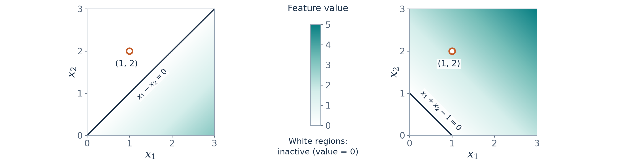
Learning can change the feature functions
An illustrative change to the first neuron's weights and bias.
Original parameters
Changed parameters
$$φ_{1}\left(x\right)=ReLU\left(x_{1}−x_{2}\right)$$
$${\tilde{φ}}_{1}\left(x\right)=ReLU\left(x_{1}+x_{2}−1\right)$$
$$\left(W_{11},W_{21},b_{1}\right)=(1,−1,0)$$
$$\left(W_{11},W_{21},b_{1}\right)=\left(1,1,−1\right)$$
$$x=\left(1,2\right): φ_{1}\left(x\right)=0 ⟶ {\tilde{φ}}_{1}\left(x\right)=2$$
The input stays the same, but the feature value changes.
Foundations of AI · Lecture 4
18
Notes:
Suggested time: 1.2 min.
This example changes only the first hidden neuron from the numerical forward pass. Originally W11=1, W21=-1 and b1=0. Illustratively change these parameters to W11=1, W21=1 and b1=-1. This is not a computed gradient-descent update. The other hidden neurons and the output parameters stay fixed.
The two plots show the scalar value of the first feature on the input plane. Both axes cover [0,3], with equal aspect ratio, and both maps use the same continuous colour scale from 0 to 5. The original feature ranges from 0 to 3 on this domain, and the changed feature ranges from 0 to 5. White regions have activation zero, as explained in the shared legend. These are activation regions, not predicted classes.
The original boundary is x1-x2=0 and the active side is x1>x2. The changed boundary is x1+x2-1=0 and the active side is x1+x2>1. Changing the weights alters the orientation, while the bias affects the offset. The weight norm is unchanged in this particular comparison.
The same input (1,2) is marked strictly inside both plots. The original first feature gives ReLU(1-2)=0, whereas the changed first feature gives ReLU(1+2-1)=2. The comparison uses only this neuron, so no other activation values need to be recalled. Changing the hidden parameters changes the feature function and hence its value at the same input.
Source: Week 4 neural network notes, the one-hidden-layer forward-pass example and discussion of learned features. The parameter perturbation is an elementary illustration extending that example.

Slide 19
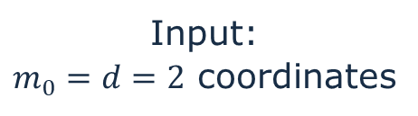

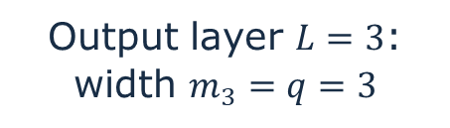


Neural Network with multiple hidden layers
Width $m_{r}$: the number of neurons in layer $r$.
By convention, $m_{0}=d$ is the input dimension and $m_{L}=q$ the output dimension.
Depth $L$: the number of layers, counting the output but excluding the input.
Input:
$m_{0}=d=2$ coordinates
Hidden layer 1:
width $m_{1}=5$
Hidden layer 2:
width $m_{2}=7$
Output layer $L=3$:
width $m_{3}=q=3$
Each additional hidden layer uses the previous layer’s activations as inputs.
The input dimension and layer widths specify the architecture: 2 → 5 → 7 → 3.
The architecture fixes parameter shapes; fitting adjusts their values.
Foundations of AI · Lecture 4
19

Slide 20
Neural Network with multiple hidden layers
Width $m_{r}$: the number of neurons in layer $r$.
By convention, $m_{0}=d$ is the input dimension and $m_{L}=q$ the output dimension.
Depth $L$: the number of layers, counting the output but excluding the input.
Input:
$m_{0}=d=2$ coordinates
Hidden layer 1:
width $m_{1}=5$
Hidden layer 2:
width $m_{2}=7$
Output layer $L=3$:
width $m_{3}=q=3$
Input: $φ_{0}\left(x\right)=x,$
Layer $r$ preactivations: $a_{r}\left(x\right)≔φ_{r−1}\left(x\right)W_{r}+b_{r} r=1,…,L−1$
Layer $r$ activations : $φ_{r}\left(x\right)≔ReLU\left(a_{r}\left(x\right)\right) r=1,…,L−1$
Output: $f_{θ}\left(x\right)≔φ_{L−1}\left(x\right)W_{L}+b_{L}$
Foundations of AI · Lecture 4
20
Notes:
Now introduce a layer index r. Bold phi_r maps the original input to the whole row of activations at hidden layer r; phi_{r,j} is its j-th scalar component. Square brackets followed by j select that component. The earlier phi_j becomes phi_{1,j}; the earlier hidden parameters W,b become W_1,b_1. Output parameters W_out,b_out become W_L,b_L. Depth L counts affine layers, including the output but excluding the input. In the pictured example L=3 and the widths are 2,5,7,3. Define phi_0(x)=x to write the recursion uniformly. ReLU applies coordinatewise.
Source: SEMTM0051_week4_neural_networks_generalisation.tex.

Slide 21
Dimensions and parameters
For the architecture $2→5→7→3$,
each layer $r$ has its own weights and biases.
$$W_{r}∈ℝ^{m_{r−1}×m_{r}}, b_{r}∈ℝ^{1×m_{r}}, r=1,…,L$$
Output parameters: $W_{L}=W_{out}$ and $b_{L}=b_{out}$.
Layer | Weight matrix | Bias row | Parameters
1 | 2 × 5 | 1 × 5 | 10 + 5 = 15
2 | 5 × 7 | 1 × 7 | 35 + 7 = 42
3 | 7 × 3 | 1 × 3 | 21 + 3 = 24
$$15+42+24=81$$
The parameter column $θ$ has 81 entries.
Foundations of AI · Lecture 4
21
Notes:
Suggested time: 1.2 min.
Ask for the size of W2 before the table. Explain the count as edges plus biases. A network architecture determines the number and shapes of parameters before they are fitted.
Source: SEMTM0051_week4_neural_networks_generalisation.tex, lecture notes by Roberto Colomboni.

Slide 22






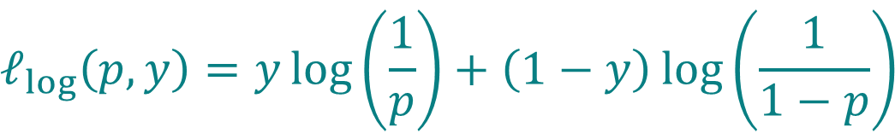
Regression and binary classification
The same scalar network output can play different roles.
Regression
Binary classification
The network output $f_{θ}(x)$
is the predicted value.
The network output $f_{θ}(x)$ is a score.
$$\hat{y}=f_{θ}(x)$$
$$p_{θ}(x)=σ\left(f_{θ}\left(x\right)\right)$$
$$h_{p_{θ}}(x)=\left\{\begin{matrix}1 & p_{θ}(x)>1/2 \\ 0 & p_{θ}(x)≤1/2\end{matrix}\right.$$
$$ℓ_{sq}\left(\hat{y},y\right)={\left(\hat{y}−y\right)}^{2}$$
$$ℓ_{log}\left(p,y\right)=y\log\left(\frac{1}{p}\right)+\left(1−y\right)\log\left(\frac{1}{1−p}\right)$$
Use the squared loss.
Use the logistic loss.
For each task, neural networks use the same loss
as the corresponding linear model.
Foundations of AI · Lecture 4
22
Notes:
Suggested time: 1.2 min.
This is the same loss choice as Lectures 2 and 3. Only the family of score functions has changed. The logistic empirical loss is a sum, with no 1/N factor.
Source: SEMTM0051_week4_neural_networks_generalisation.tex, lecture notes by Roberto Colomboni.
Convention: the Heaviside step function is 0 for s<=0 and 1 for s>0, including step(0)=0. Thus h(x)=step(f_theta(x)): class 1 requires p_theta(x)>1/2, equivalently a strictly positive score. Probability 1/2 or score zero gives class 0, the smaller binary class index.

Slide 23
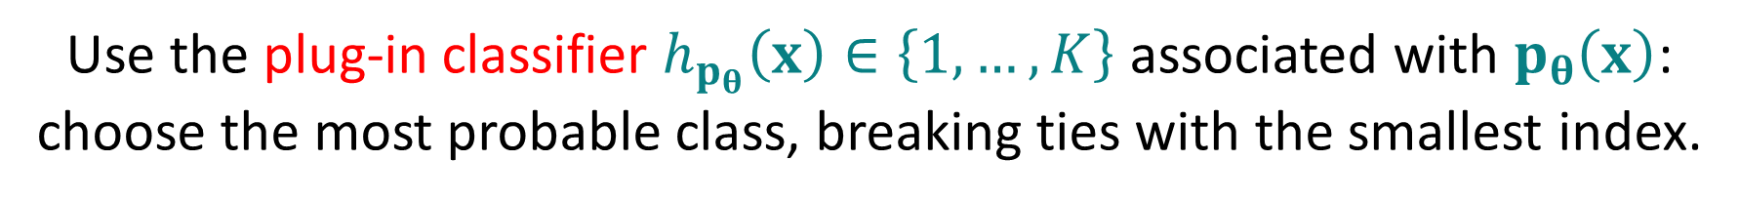

Multiclass classification
With $K$ classes, the network outputs a row of $K$ real scores.
The output width is $m_{L}=q=K$.
$$f_{θ}\left(x\right)∈ℝ^{1×K}$$
$$p_{θ}\left(x\right)=Softmax\left(f_{θ}\left(x\right)\right)∈{\left(0,1\right)}^{1×K}$$
Use the plug-in classifier $h_{p_{θ}}\left(x\right)∈\left\{1,…,K\right\}$ associated with $p_{θ}\left(x\right)$:
choose the most probable class, breaking ties with the smallest index.
Fit with the same cross-entropy loss
$$ℓ_{multi}\left(p,y\right)=−log\left(p_{y}\right)$$
Foundations of AI · Lecture 4
23
Notes:
Suggested time: 1.1 min.
Recall Softmax for a full row of probabilities from Lecture 3. The component formula makes the normalization explicit. Argmax gives the set of indices with maximal probability. The outer min selects the smallest class index in a tie. This agrees with choosing class 0 in the binary case when both labels have probability 1/2.
Source: SEMTM0051_week4_neural_networks_generalisation.tex, lecture notes by Roberto Colomboni.

Slide 24
Today’s lecture
Affine features and activation functions
Neural networks and the forward pass
What neural networks can represent
Fitting neural networks and local minima
Foundations of AI · Lecture 4
24
Notes:
Part 3: What neural networks can represent. Briefly locate this part in the lecture before continuing.

Slide 25

A regression problem: the tent function
We could choose this function as a fixed feature.
$$x$$
Can we build it
by adjusting the parameters of a Neural Network?
Foundations of AI · Lecture 4
25
Notes:
Suggested time: 0.5 min.
Show the complete target before constructing it. It is zero before x=0, rises to one at x=1, falls to zero at x=2, and stays zero afterwards. A single affine function cannot reproduce these changes of slope.
We could choose this as a fixed feature, as in Lecture 2. Here we will construct it using ReLU units with adjustable weights and biases. In this example we choose the parameters by hand to make their roles visible. This establishes representational capacity; it does not show that training will find the parameters.
Source: SEMTM0051_week4_neural_networks_generalisation.tex, What the hidden layers can represent and Three ReLUs can form a triangular function.

Slide 26


Building a tent function: start
At $x = 0$, the slope changes from $0$ to $+1$.
$$T_{1}\left(x\right)=ReLU\left(x\right)$$
One neuron
width $m_{1}=1$
The target returns
to zero.
$$x$$
One ReLU creates one change of slope.
Foundations of AI · Lecture 4
26
Notes:
Suggested time: 1 min.
The dashed grey curve is the target. The coloured curve is the current sum. Keep the axes fixed so students can compare the three constructions. These parameters are chosen by hand.
Source: SEMTM0051_week4_neural_networks_generalisation.tex, lecture notes by Roberto Colomboni.

Slide 27
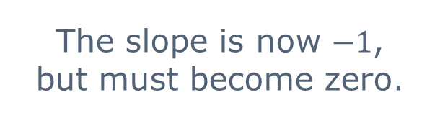

Building a tent function: turn
At $x = 1$, the second neuron changes the slope by $−2$.
$$T_{2}\left(x\right)=ReLU\left(x\right)−2ReLU\left(x−1\right)$$
Two neurons
width $m_{1}=2$
The slope is now $−1$,
but must become zero.
$$x$$
The output weights can be negative.
Foundations of AI · Lecture 4
27
Notes:
Suggested time: 1 min.
The dashed grey curve is the target. The coloured curve is the current sum. Keep the axes fixed so students can compare the three constructions. These parameters are chosen by hand.
Source: SEMTM0051_week4_neural_networks_generalisation.tex, lecture notes by Roberto Colomboni.

Slide 28

Building a tent function: stop
At $x = 2$, the third neuron changes the slope by $+1$.
$$T\left(x\right)=ReLU\left(x\right)−2ReLU\left(x−1\right)+ReLU\left(x−2\right)$$
Three neurons
width $m_{1}=3$
The slope returns to zero.
The tent is complete.
$$x$$
Three neurons can produce the tent function.
Foundations of AI · Lecture 4
28
Notes:
Suggested time: 0.5 min.
The third hidden unit computes ReLU(x-2). Its output weight is +1, so it adds a slope of +1 after x=2 and cancels the previous slope of -1. The combined output is zero before x=0, rises to one at x=1, falls to zero at x=2 and remains zero afterwards. This completes the sequence of one, two and three hidden units.
Source: SEMTM0051_week4_neural_networks_generalisation.tex.

Slide 29




The parameters of the tent network
The tent function can be represented by a neural network with architecture: 1 → 3 → 1
$$T\left(x\right)=1⋅ReLU(1⋅x+0)−2⋅ReLU(1⋅x+(−1))+1⋅ReLU(1⋅x+(−2))+0$$
$$W_{1}=\left(1,1,1\right)$$
$$b_{1}=\left(0,−1,−2\right)$$
$$W_{2}={\left(1,−2,1\right)}^{T}$$
$$b_{2}=\left(0\right)$$
$$x$$
The biases place the breakpoints. The output weights change the slopes.
Foundations of AI · Lecture 4
29
Notes:
Suggested time: 0.6 min.
The triangular predictor uses one scalar input and one hidden layer of width three. The hidden weight row W=(1,1,1) and bias row b=(0,-1,-2) give the feature values ReLU(x), ReLU(x-1) and ReLU(x-2). The output weight column is (1,-2,1)^T and the output bias is zero. These parameters reproduce the completed triangular function on the preceding slide.
Source: SEMTM0051_week4_neural_networks_generalisation.tex.
The explicit parameters control the construction: hidden biases set the breakpoints, and the output weights change the slopes. These parameters can be fitted to data instead of chosen by hand. Adjusting arbitrary individual parameters need not preserve an exact tent shape.

Slide 30

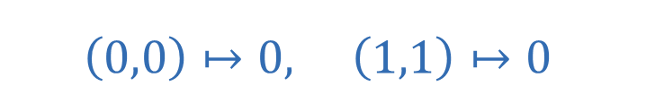
A classification problem: the XOR function
The label is $1$ when exactly one input coordinate is $1$.
$$\left(0,0\right)↦0, \left(1,1\right)↦0$$
$$\left(1,0\right)↦1, \left(0,1\right)↦1$$
x₁
Can one straight-line decision boundary classify all four observations?
Foundations of AI · Lecture 4
30
Notes:
Suggested time: 1.1 min.
Only four observations. This example asks whether an affine score can correctly classify these data using the same threshold convention as Lecture 3.
Source: SEMTM0051_week4_neural_networks_generalisation.tex, lecture notes by Roberto Colomboni.

Slide 31



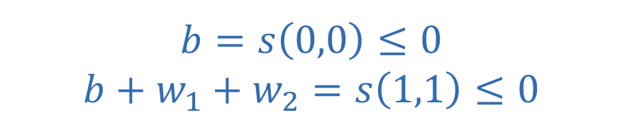
Why an affine score cannot solve XOR
The score must be positive for class $1$ and nonpositive for class $0$.
$$s\left(x\right)=b+w_{1}x_{1}+w_{2}x_{2}$$
Class 0 observations
Class 1 observations
$$b=s\left(0,0\right)≤0$$
$$b+w_{1}+w_{2}=s\left(1,1\right)≤0$$
$$b+w_{1}=s\left(1,0\right)>0$$
$$b+w_{2}=s\left(0,1\right)>0$$
Adding the inequalities within each class
gives two incompatible inequalities.
$$2b+w_{1}+w_{2}≤0$$
$$2b+w_{1}+w_{2}>0$$
Foundations of AI · Lecture 4
31
Notes:
Suggested time: 1.7 min.
Use h=0 at score zero. The class 0 observations require b<=0 and b+w1+w2<=0. The class 1 observations require b+w1>0 and b+w2>0. Adding each pair gives 2b+w1+w2<=0 and 2b+w1+w2>0, which contradict each other. This proof is short enough for the slide.
Source: SEMTM0051_week4_neural_networks_generalisation.tex, lecture notes by Roberto Colomboni.

Slide 32
Two features that solve XOR
The XOR function can be represented by a neural network with architecture: 2 → 2 → 1
$$φ_{1}\left(x\right)=ReLU\left(x_{1}−x_{2}\right), φ_{2}\left(x\right)=ReLU\left(x_{2}−x_{1}\right)$$
$$f_{θ}\left(x\right)=φ_{1}\left(x\right)+φ_{2}\left(x\right)−\frac{1}{2}=\left|x_{1}−x_{2}\right|−\frac{1}{2}$$
$$W_{1}=\left(\begin{matrix}1 & −1 \\ −1 & 1\end{matrix}\right), b_{1}=\left(0,0\right), W_{2}=\left(\begin{matrix}1 \\ 1\end{matrix}\right), b_{2}=\left(−\frac{1}{2}\right)$$
Input row | Feature row | Score | Label
(0, 0) | (0, 0) | −0.5 | 0
(1, 0) | (1, 0) | +0.5 | 1
(0, 1) | (0, 1) | +0.5 | 1
(1, 1) | (0, 0) | −0.5 | 0
Foundations of AI · Lecture 4
32
Notes:
Suggested time: 1.8 min.
Use phi without a layer subscript in this standalone example. The table evaluates every observation. All four labels are correct, but sigmoid probabilities are only about .378 or .622. Correct classification is not zero logistic loss.
Source: SEMTM0051_week4_neural_networks_generalisation.tex, lecture notes by Roberto Colomboni.
The binary rule is h(x)=1 only when f(x)>0, and h(x)=0 when f(x)<=0. All scores in this table are +0.5 or -0.5, so the predictions are unchanged by the convention at zero.

Slide 33




A straight boundary in feature space
Non-affine features allow an affine output to produce
a nonlinear decision boundary in the original input space.
Input space
Feature space
Class 1
Class 1
Class 0
$$φ_{2}(x)$$
Class 0
Class 1
x₁
$$φ_{1}(x)$$
$$\left|x_{1}−x_{2}\right|=\frac{1}{2}$$
$$φ_{1}\left(x\right)+φ_{2}\left(x\right)=\frac{1}{2}$$
$\left(0, 0\right)$ and $\left(1, 1\right)$ both map to the origin.
Foundations of AI · Lecture 4
33
Notes:
Suggested time: 2.1 min.
The input plane has two boundary lines. The feature plane needs one line. Both class 0 inputs map exactly to (0,0); this intentional collision is labelled, not jittered. Coordinates in the right plot are feature values.
Source: SEMTM0051_week4_neural_networks_generalisation.tex, lecture notes by Roberto Colomboni.
The output is affine in the hidden feature values. Since those features are nonlinear functions of the original input, the corresponding decision boundary in input space need not be a single straight line. The figure shows this directly. A suitable fixed feature expansion could also solve XOR; this example illustrates the network construction and the change of geometry.
Boundary convention: points with |x1-x2|=1/2, equivalently phi1(x)+phi2(x)=1/2, have output score zero and receive class 0. Class 1 requires strict inequality >1/2. The boundary locations and the four plotted observations are unchanged.

Slide 34
Today’s lecture
Affine features and activation functions
Neural networks and the forward pass
What neural networks can represent
Fitting neural networks and local minima
Foundations of AI · Lecture 4
34
Notes:
Part 4: Fitting neural networks and local minima. Briefly locate this part in the lecture before continuing.

Slide 35

Fitting all weights and biases
The observations stay fixed. The network parameters vary.
Regression
Binary Classification
$$ℒ_{sq}\left(θ\right)=\sum_{i=1}^{N}{ℓ_{sq}\left(f_{θ}\left(x_{i}\right),y_{i}\right)}, ℒ_{log}\left(θ\right)=\sum_{i=1}^{N}{ℓ_{log}\left(p_{θ}\left(x_{i}\right),y_{i}\right)}​$$
Let $ℒ$ be the empirical loss for the task.
Where differentiable, we update the parameters by gradient descent.
$$θ^{\left(t+1\right)}=θ^{\left(t\right)}−η∇ℒ\left(θ^{\left(t\right)}\right), η>0$$
For neural networks,
will gradient descent converge to a global minimum?
Foundations of AI · Lecture 4
35
Notes:
Suggested time: 1.3 min.
Use a generic per-observation loss: squared for regression or a classification loss applied after the appropriate probability link. All current derivatives are computed before updating parameters.
Source: SEMTM0051_week4_neural_networks_generalisation.tex, lecture notes by Roberto Colomboni.

Slide 36




A network with one adjustable parameter
To visualise the empirical loss, we vary only one scalar parameter $θ$.
The hidden biases are $−θ$ and $θ$. All other coefficients stay fixed.
$L=2$, with widths $m_{0}=1$, $m_{1}=2$ and $m_{2}=1$.
$$f_{θ}\left(x\right)=ReLU\left(x−θ\right)+ReLU\left(θ−x\right)−3=\left|x−θ\right|−3$$
$$θ = −1$$
$$θ = +1$$
Hidden bias row:
$$b_{1}=\left(−θ,θ\right)$$
The two biases vary together
and remain opposites.
Changing $θ$ shifts the
graph horizontally.
x
Similar optimisation difficulties can also occur
in networks where all parameters can vary.
Foundations of AI · Lecture 4
36
Notes:
Suggested time: 1.3 min.
This is a restricted family. Hidden biases are tied to the same scalar with opposite signs. Do not claim that the local minima remain local minima when all weights and biases are released. Horizontal axis of this graph is x, not theta.
Source: SEMTM0051_week4_neural_networks_generalisation.tex, lecture notes by Roberto Colomboni.

Slide 37
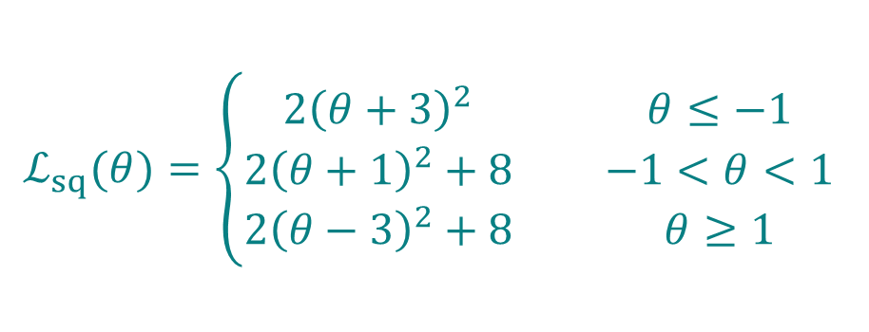
The regression loss
Two observations: $\left(x_{1},y_{1}\right)=\left(−1, −1\right)$and $\left(x_{2},y_{2}\right)=\left(1, 1\right)$.
$$ℒ_{sq}\left(θ\right)={\left(f_{θ}\left(−1\right)+1\right)}^{2}+{\left(f_{θ}\left(1\right)−1\right)}^{2}$$
$$ℒ_{sq}(θ)=\left\{\begin{matrix}2{\left(θ+3\right)}^{2} & θ≤−1 \\ 2{\left(θ+1\right)}^{2}+8 & −1<θ<1 \\ 2{\left(θ−3\right)}^{2}+8 & θ≥1\end{matrix}\right.$$
θ
The loss is a function of $θ$. Its graph has two valleys.
Foundations of AI · Lecture 4
37
Notes:
Suggested time: 1.4 min.
Now the horizontal axis is the adjustable parameter theta. The data points are fixed. Derive the first piece orally if time permits; the notes contain every interval calculation.
Source: SEMTM0051_week4_neural_networks_generalisation.tex, lecture notes by Roberto Colomboni.

Slide 38
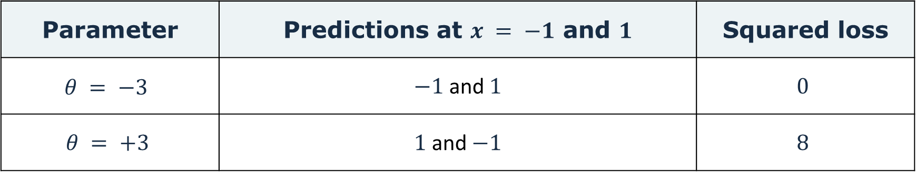


Two stationary points, different losses
Both points have derivative zero, but their losses are different.
Parameter | Predictions at $x = −1$ and $1$ | Squared loss
$$θ = −3$$ | $−1$ and $1$ | $$0$$
$$θ = +3$$ | $1$ and $−1$ | $$8$$
Global minimum at $θ = −3$
Local minimum at $θ = +3$
No parameter value
has a smaller loss.
No sufficiently small change
improves the loss.
Foundations of AI · Lecture 4
38
Notes:
Suggested time: 1.2 min.
At -3 the squared loss is zero and therefore globally minimal. At +3 the loss increases for small nonzero moves but is larger than at -3: a strict local minimum in this restricted family. Zero derivative alone does not distinguish them.
Source: SEMTM0051_week4_neural_networks_generalisation.tex, lecture notes by Roberto Colomboni.

Slide 39
The same difficulty in classification
Two observations: $\left(x_{1},y_{1}\right)= \left(−1, 0\right)$and $\left(x_{2},y_{2}\right)= \left(1, 1\right)$.
$$p_{θ}\left(x\right)=σ\left(f_{θ}\left(x\right)\right), ℒ_{log}\left(θ\right)=−log\left(1−p_{θ}\left(−1\right)\right)−log\left(p_{θ}\left(1\right)\right)$$
θ | Logistic loss | Mistakes
−3 | 0.627 | 0 of 2
+3 | 2.627 | 2 of 2
θ
The local minimum can give much worse predictions than the global one.
Foundations of AI · Lecture 4
39
Notes:
Suggested time: 1.3 min.
The same scalar network gives a sigmoid probability. Natural logarithms. Global loss 2log(1+exp(-1))=.626523375, local loss 2log(1+exp(1))=2.626523375. Both stationary. Predictions reverse at +3.
Source: SEMTM0051_week4_neural_networks_generalisation.tex, lecture notes by Roberto Colomboni.

Slide 40








Gradient descent: two starting points
Initial values $θ^{(0)} = −1.5$ and $+1.5$. Learning rate $η = 0.05$.
$$t = 0$$
$$t = 1$$
$$t = 2$$
$$t = 5$$
$$t = 10$$
$$t = 20$$
θ
θ
θ
θ
θ
θ
θ
Start at $−1.5$
Start at $+1.5$
$$θ^{(0)}≈−1.5000, ℒ_{sq}\left(θ^{(0)}\right)≈4.5000$$
$$θ^{(1)}≈−1.8000, ℒ_{sq}\left(θ^{(1)}\right)≈2.8800$$
$$θ^{(2)}≈−2.0400, ℒ_{sq}\left(θ^{(2)}\right)≈1.8432$$
$$θ^{(5)}≈−2.5085, ℒ_{sq}\left(θ^{(5)}\right)≈0.4832$$
$$θ^{(10)}≈−2.8389, ℒ_{sq}\left(θ^{(10)}\right)≈0.0519$$
$$θ^{(20)}≈−2.9827, ℒ_{sq}\left(θ^{(20)}\right)≈0.0006$$
$$θ^{(0)}≈1.5000, ℒ_{sq}\left(θ^{(0)}\right)≈12.5000$$
$$θ^{(1)}≈1.8000, ℒ_{sq}\left(θ^{(1)}\right)≈10.8800$$
$$θ^{(2)}≈2.0400, ℒ_{sq}\left(θ^{(2)}\right)≈9.8432$$
$$θ^{(5)}≈2.5085, ℒ_{sq}\left(θ^{(5)}\right)≈8.4832$$
$$θ^{(10)}≈2.8389, ℒ_{sq}\left(θ^{(10)}\right)≈8.0519$$
$$θ^{(20)}≈2.9827, ℒ_{sq}\left(θ^{(20)}\right)≈8.0006$$
Foundations of AI · Lecture 4
40
Notes:
Five clicks reveal t=1,2,5,10,20, starting from t=0. Both initialisations update simultaneously. Learning rate eta=.05. Each frame contains every actual intermediate GD segment up to its displayed t, not one artificial large jump. The blue and orange filled points show current iterates. Hollow circles retain the two initial positions. Parameter and loss readouts use four decimal places, with approximation signs. At t=20 neither run has reached its limiting minimum exactly. Values are calculated from f_theta(x)=|x-theta|-3 with the fixed observations from the notes. Suggested time: 1.1 min. Source: Week4 lecture notes, section7.

Slide 41

Gradient descent with logistic loss
Initial values $θ^{(0)} = −1.5$and $+1.5$. Learning rate $η = 0.5$.
$$t = 0$$
$$t = 1$$
$$t = 2$$
$$t = 5$$
$$t = 10$$
$$t = 20$$
θ
θ
θ
θ
θ
θ
θ
Start at $−1.5$
Start at $+1.5$
$$θ^{(0)}≈−1.5000, ℒ_{log}\left(θ^{(0)}\right)≈1.0530$$
$$θ^{(1)}≈−1.7733, ℒ_{log}\left(θ^{(1)}\right)≈0.9154$$
$$θ^{(2)}≈−2.0028, ℒ_{log}\left(θ^{(2)}\right)≈0.8190$$
$$θ^{(5)}≈−2.4747, ℒ_{log}\left(θ^{(5)}\right)≈0.6806$$
$$θ^{(10)}≈−2.8233, ℒ_{log}\left(θ^{(10)}\right)≈0.6327$$
$$θ^{(20)}≈−2.9802, ℒ_{log}\left(θ^{(20)}\right)≈0.6266$$
$$θ^{(0)}≈1.5000, ℒ_{log}\left(θ^{(0)}\right)≈3.0530$$
$$θ^{(1)}≈1.7733, ℒ_{log}\left(θ^{(1)}\right)≈2.9154$$
$$θ^{(2)}≈2.0028, ℒ_{log}\left(θ^{(2)}\right)≈2.8190$$
$$θ^{(5)}≈2.4747, ℒ_{log}\left(θ^{(5)}\right)≈2.6806$$
$$θ^{(10)}≈2.8233, ℒ_{log}\left(θ^{(10)}\right)≈2.6327$$
$$θ^{(20)}≈2.9802, ℒ_{log}\left(θ^{(20)}\right)≈2.6266$$
Foundations of AI · Lecture 4
41
Notes:
Five clicks reveal t=1,2,5,10,20, starting from t=0. Both initialisations update simultaneously. Learning rate eta=.5. Each frame contains every actual intermediate GD segment up to its displayed t, not one artificial large jump. The blue and orange filled points show current iterates. Hollow circles retain the two initial positions. Parameter and loss readouts use four decimal places, with approximation signs. At t=20 neither run has reached its limiting minimum exactly. Values are calculated from f_theta(x)=|x-theta|-3 with the fixed observations from the notes. Suggested time: 1.1 min. Source: Week4 lecture notes, section7.

Slide 42
Finding useful solutions in practice
These practical heuristics can help,
without guaranteeing convergence to a global minimum.
Try different initialisations
Different starting points can lead to different final parameters.
Keep track of which runs fit the training data better.
Change how the updates are computed
Stochastic Gradient Descent: use gradients from small random subsets.
This may help the iterates leave the region around a local minimum.
Consider increasing the width
A wider network can sometimes be easier to optimise.
Increasing width does not guarantee that gradient descent
reaches a global minimum.
Foundations of AI · Lecture 4
42
Notes:
Suggested time: 1.8 min.
These are practical heuristics in a general application. Different initialisations compare training fits; validation data assess generalisation. Minibatches use a randomly selected subset instead of all observations, so their gradient need not vanish where the full gradient does. Momentum accumulates information from past gradients and can reinforce consistent update directions. Adam combines a moving average of gradients with adaptive parameter-wise scaling based on squared gradients. These choices change the optimisation trajectory without guaranteeing escape from every local minimum.
Width result: Quynh Nguyen (2019), On Connected Sublevel Sets in Deep Learning, ICML, Theorem 6.1. For fully connected ReLU networks, distinct training inputs, a loss convex in the network outputs, and every hidden layer of width at least N (the number of training inputs), the loss has no bad local valleys. For one hidden layer this condition is m >= N. This concerns the geometry of the training loss and is not a theorem guaranteeing convergence of gradient descent. Non-strict suboptimal local minima on flat regions can remain. https://proceedings.mlr.press/v97/nguyen19a/nguyen19a.pdf
Momentum reference: Sutskever et al. (2013), On the importance of initialization and momentum in deep learning. https://proceedings.mlr.press/v28/sutskever13.pdf. Adam reference: Kingma and Ba (2015), Adam: A Method for Stochastic Optimization. https://arxiv.org/abs/1412.6980.
Source: SEMTM0051_week4_neural_networks_generalisation.tex, lecture notes by Roberto Colomboni.

Slide 43
Computing the gradient
Gradient descent requires the derivative of the loss
with respect to every weight and bias.
The network composes affine transformations and activation functions.
We then evaluate the loss.
Where these operations are differentiable,
we apply the chain rule through this composition.
ReLU is not differentiable at zero.
For parameter updates, we use 0 as its multiplier there.
This is a computational convention, not an ordinary derivative.
Backpropagation organises this calculation efficiently.
Next lecture: backpropagation.
Foundations of AI · Lecture 4
43
Notes:
Suggested time: 1 min.
Gradient descent needs the loss gradient with respect to all network parameters. As in logistic regression, differentiating the loss requires following a composition of functions. Each network layer applies an affine transformation and an activation function, and the loss acts on the final prediction. The chain rule connects these operations. Backpropagation organises the calculation efficiently by reusing intermediate derivatives in a backward pass. Lecture 5 develops that calculation.
Source: SEMTM0051_week4_neural_networks_generalisation.tex, lecture notes by Roberto Colomboni.

Slide 44

Lecture notes and exercises
The notes for today's lecture are available
on the course GitHub page.
They explain the material in more detail
and include exercises.
I will post the exercise solutions
before the next lecture.
github.com/semtm0051/2026_27
Scan for course materials
44
Notes:
The lecture notes on the course GitHub page give further detail and exercises. Exercise solutions are posted before the next lecture. The hyperlink and QR code both lead to the course repository.
Course materials: https://github.com/semtm0051/2026_27

